Slide 1

Model Selection (and Validation)
Rayid Ghani and Kit Rodolfa

Slide 2
Short Quiz

Slide 3
Reminders
This week:
Project check-in on Wednesday
Temporal Validation “whiteboard” session Thursday
Project Assignment due on Friday – see template slides
Self & peer contribution survey due Friday
Coming up next week:
Reading for Tuesday
Next project assignment due following Monday (Oct 19)
Modeling plan and feature list

Slide 4
Plan for the week
What you should be discussing this week within your team
Finalizing your analytical formulation and baselines to compare against
Modeling metrics and validation strategy
What you should be building this week
V0 of your ML pipeline
1 cohort, 1 label, 1 feature from each data source, 1 train-test set, 1 model, 1 metric
Submit code on git repo by this Friday along with project assignment

Slide 5
Scope
Data
Exploration
Modeling
Get Data
Store Data
Link Data
Rows
Features
Labels
Model Selection
Train-Test Splits
Performance Metrics
Model Interpretation
Entities
temporal
Spatial
…
Models
Dealing with Bias and Fairness
Field Trial Design
Deployment
Monitoring
Goals, Actions, Data, Analysis, Ethics

Slide 6
How to solve a prediction problem
Define and Create Rows (unit of prediction)
Define and Create Label (outcome/target variable – what event and when?)
Define and Create Features (features/predictors)
Create Training and Validation/Test Sets
Train model(s) on Training Set(s)
Validate model(s) on Validation/Test Set(s)
Select “best” model

Slide 7
What is the goal of model selection?

Slide 8
What is the goal of model selection?
You’ve run a large number of different types of models varying …
You need to understand what types of models are effective under what circumstances, and
You need to decide which one(s) to use in the future

Slide 9
What do we need our selected model to do?

Slide 10
What do we need our selected model to do?
Perform well
What metric?
Compared to what?
Generalize
To what?

Slide 11
What should the model we select generalize to?

Slide 12
What do need to know to perform model selection
Deployment scenario
Model selection Methodology
Metric(s) (need to match your policy goals)
Comparison with baselines (to know if you’re effective)

Slide 13
How do we select a model that does that?

Slide 14
Model Selection - Methodology
In-sample
Out of sample
Multiple Out-of-sample (Hold-out) Splits
Cross Validation
Leave one out (LOO)
K fold
Temporal Holdouts
Spatial Holdouts
Other Holdouts?

Slide 15
Scenarios
1: We want to track news coverage of epidemic related topics. We have tagged a small corpus (n=1000) of news articles from Jan 2019 to September 2020 and now have a stream of new incoming articles every day. We want to deploy a system that tells us something about intensity of coverage by media outlet going forward.
What should our model generalize to?
What is a training set?
What is the corresponding validation set?

Slide 16
Scenarios
2: We want to track news coverage of epidemic related topics. We have tagged a small corpus (n=1000) of news articles from Jan 2019 to September 2020 and now have a stream of new incoming articles every day. We want to deploy a system that tells us something about intensity of coverage by media outlet over the last 2 years as well as going forward.
What should our model generalize to?
What is a training set?
What is the corresponding validation set?

Slide 17
Scenarios
3: We want to predict whether there will be an increase in epidemic related articles in the media during the next week.
What should our model generalize to?
What is a training set?
What is the corresponding validation set?

Slide 18
Scenarios
4: We want to predict whether there will be an increase in epidemic related articles in the media during the next month.
What should our model generalize to?
What is a training set?
What is the corresponding validation set?

Slide 19
Parameters

Slide 20
Performance Metrics

Slide 21
Score Distribution on the Test Set
# of people
Score

Slide 22
Evaluation - Metrics
Predictions are often scores between 0 and 1
We need to first turn them into 0 or 1 by selecting a threshold
Predicted Class
 | Yes | No
Yes | True Positives (TP) | False Negatives (FN)
No | False Positives (FP) | True Negatives (TN)
Actual Class

Slide 23
Evaluation – Metrics (at a threshold k)
Accuracy = (TP + TN) / (TP + TN + FP + FN)
Precision (or PPV) = TP / (TP + FP)
Recall (or Sensitivity) = TP / (TP + FN)
Specificity = TNR
Predicted
 | Yes | No
Yes | True Positives (TP) | False Negatives (FN)
No | False Positives (FP) | True Negatives (TN)
Actual

Slide 24
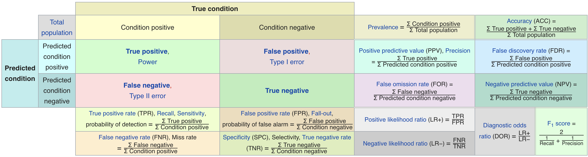
Metric Cheatsheet
Source: https://en.wikipedia.org/wiki/Sensitivity_and_specificity

Slide 25
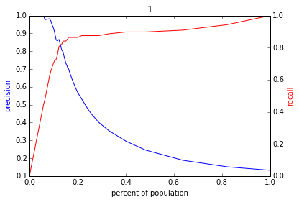
Varying the Threshold
Score
1 .9 .8 .7 .6 .5 .4 .3. .2 .1
| | | | | | | | | |
Baseline

Slide 26
ROC Curve
Receiver Operator Characteristic Curve

Slide 27
AUC (Area Under Curve)
Overall measure of performance
1 if all 1s are ranked above all 0s
0 if all 0s are above all 1s

Slide 28
Evaluation - Baselines
Random (predict most frequent class)
Simple heuristics
Expert heuristics (what may be in use today)

Slide 30
AUC – Area Under Curve
If you care about the entire space

Slide 31
Reminders
This week:
Project check-in on Wednesday
Temporal Validation “whiteboard” session Thursday
Project Assignment due on Friday
Self & peer contribution survey due Friday
Coming up next week:
Reading for Tuesday
Next project assignment due following Monday (Oct 19)
Modeling plan and feature list

